Slide 1


Car price prediction
Sivarangareddy pondugula
811197074

Slide 2
Table of content
Problem statement
Overview of the dataset
Data preparation and explore
Modeling approaches
Performance evaluations
Insights and conclusions

Slide 3
Problem statement
A Chinese automobile company Geely auto aspires to enter the US market by setting up their manufacturing unit there and producing cars locally to give competition to their US and European counterparts.
They have contracted an automobile consulting company to understand the factors on which the pricing of cars depends. Specifically, they want to understand the factors affecting the pricing of cars in the American market since those may be very different from the Chinese market.
The company wants to know:
• which variables are significant in predicting the price of a car
• how well do those variables describe the price of a car

Slide 4
OVERVIEW OF DATASET
The data set contains information regarding the various factors influencing the price of a particular car.
There are a total of 26 columns/attributes like car name, fuel type, city mpg etc also with the output variable/attribute price.
There are a total of 205 observations in each column.
No missing values or imbalanced data.
No null values

Slide 5
Data preparation and explore
dropped the few variables which exactly resemble duplicates like Car_id
Heatmap helps to understand the data
There are 7 variables highly positively related to output variable price. Two are negatively related to price.
Identified Multicollinearity between a few variables
To remove or reduce Multicollinearity created a few new variables with old intercorrelated variables and dropped those.
made new variable as company segment based on brand value
Few car name companies are misspelt corrected those

Slide 6
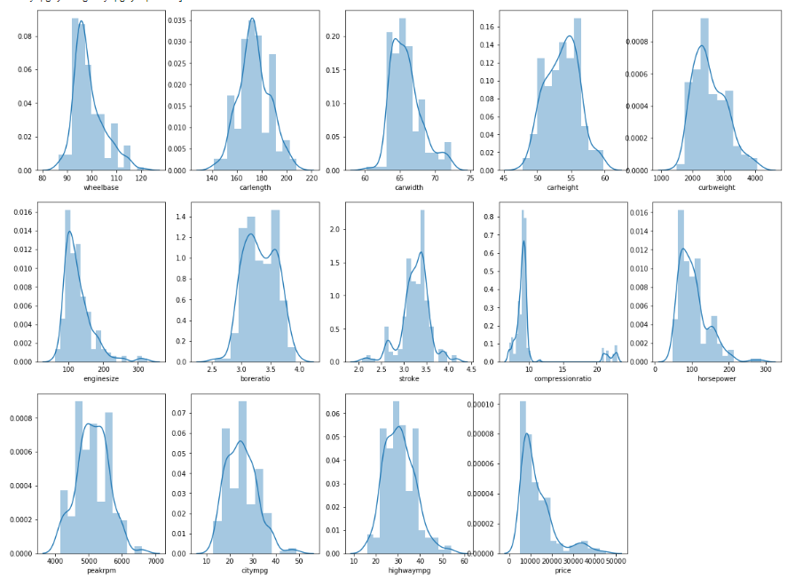
Outlier Treatment
Linear regression is very sensitive to outliers
Engine size, horsepower and compression ratio variables have a right-skewed distribution,
We have treated the outlier by clipping variables at 96%values and a compression ratio of 90%
We kept car data for which the price is less than 3 standard deviations.

Slide 7
Data preparation and explore
Handling Categorical Variable
converted the categorical variables to numeric All this conversion has taken place as dummy variables
Test and train data
We have divided 70% of data as train and 30% data as test data
Feature scaling
applied min-max scaler to all numeric variables scale is in between 0 to 1
Applied scaler to all variables except yes or no and dummy variables

Slide 8
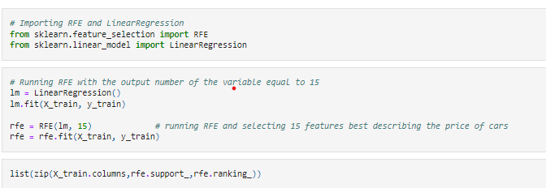
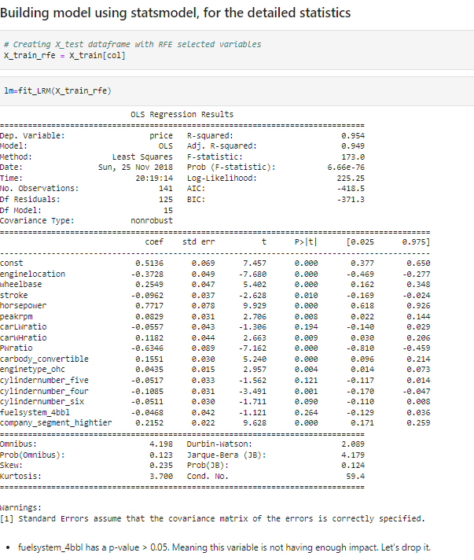
Modelling approaches
Applied Linear Regression function from SciKit Learn for its compatibility with RFE (Recursive feature elimination ) and applied variance inflation factor.
Ran the train data until we got all the significant factors and then used the stat model for statistical Analysis
we have removed many non-significant variables and high multicollinearity variables
In linear regression train model_10 th time we got all the independent variables with all significant and are considerably low variance influence factor.
Same scaling procedure and same variable applied to test data

Slide 9
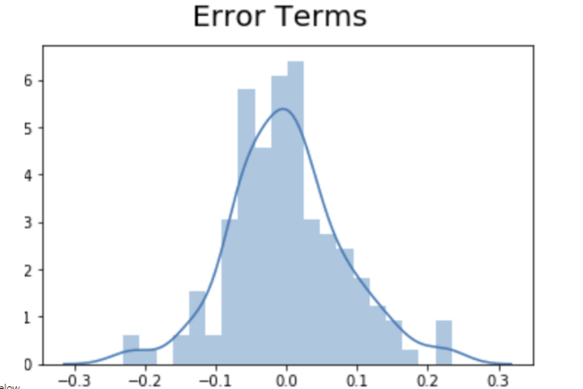
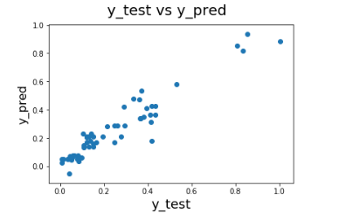
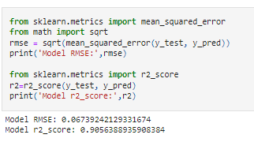
Performance evaluation
The above error term distribution indicates the error term is almost normally distributed and centered zero
y_test VS y_pred is observed to be almost linear with some variation occurring. Overall, it is a pretty linear spread.
r2_score on the test data is very close to the trained Adj. R-Squared value of the model. we have a significantly high r2_score and a low RMSE of 0.067.
Among three regression models we found random forest is best with an accuracy of 92.9%.

Slide 10
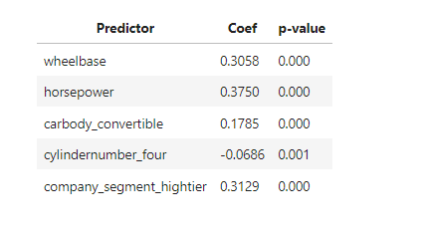
Insights and conclusion
we have a variable with low VIF and p values. This variable explains the price to a great extent. Overall, this model is best fits model with an accuracy of 91%
The best-fitted Equation
Price = -0.0133 + 0.3058 *wheelbase +0.3750*horsepower+0.1785* Car body Convertible -0.0686* cylinder number four +0.3129* company segment high tier
all the independent variables are considerably low variance influence factor, and r squared 0.910, which means 91% and adjusted r squared is 90.7% relatively high which has significantly fit to the model
As we can see we have applied all three regression models to data we found random forest is best with an accuracy of 92.9%.

